Slide 1


Titolo presentazione sottotitolo
Power Network System
Project for the course of Networked Control
Group members: Maggi Donatello
Marino Davide
Spinelli Nicolò
Milano, XX mese 20XX

Slide 2
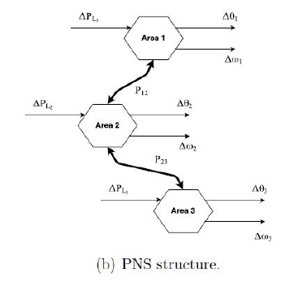
System description and initial analisys
The system is composed by 5 power generation areas, each one displaying 4 states 𝑥𝑖=[Δ𝜃𝑖, Δ𝜔𝑖, Δ𝑃𝑚,𝑖, Δ𝑃𝑣,𝑖]^𝑇, being:
Δ𝜃𝑖: Deviation of the angular displacement of the rotor with respect to the stationary reference axis on the stator.
Δ𝜔𝑖: Speed deviation of rotating mass from nominal value.
Δ𝑃𝑚,𝑖: Deviation of the mechanical power from nominal value (p.u.).
Δ𝑃𝑣,𝑖: Deviation of the steam valve position from nominal value (p.u.).

Slide 3
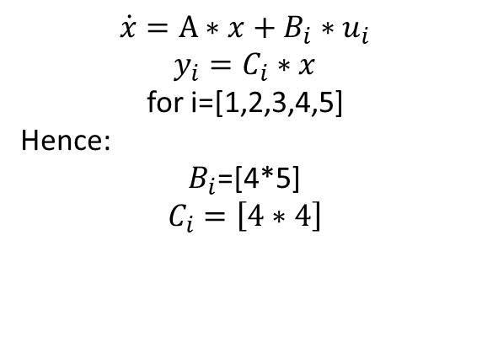
System description and initial analisys
Each area displays an input Ui, the deviation of the requested load from the nominal value; the system
can therefore be decomposed into 5 subsystem corresponding to the connected areas.
For simplicity, we just report the dimensions of the subsystems (all equal between one another) without displaying the matrices.
This way, all components of u and y belong to one subsystem, and all 5 of them have an input and an output.
A=[20*20]
B=[20*5]
C=[20*20]
D=[ ];
$$\dot{x}=A∗x+B_{i}∗u_{i}$$
$$y_{i}=C_{i}∗x$$
for i=[1,2,3,4,5]
Hence:
$B_{i}$=[4*5]
$$C_{i}=\left[4∗4\right]$$

Slide 4
Open loop system
Eigenvalues of the system in open loop have been computed, resulting in a spectral abscissa (the maximum between all the real parts of the 20 eig)=0.
The system is therefore simply stable (this will not be highlighted in the movements’ graph since the simply stable eigenvalues are not associated with our state of interest)
The corresponding discrete_time system is obtained directly using the command:
[F,G,H,L,h]=ssdata(c2d(ss(A,B,C,[]),h))
where we set h=1s as indicated in the text.
As expected, the discrete system displays an eigenvalue on the unit circle (spectral radius=1), and is simply stable too.
The sampling time h seemed consistent with the free dynamics of the open loop system, which stabilize around 5s. We therefore opted not to change it (RIGUARDARE)

Slide 5
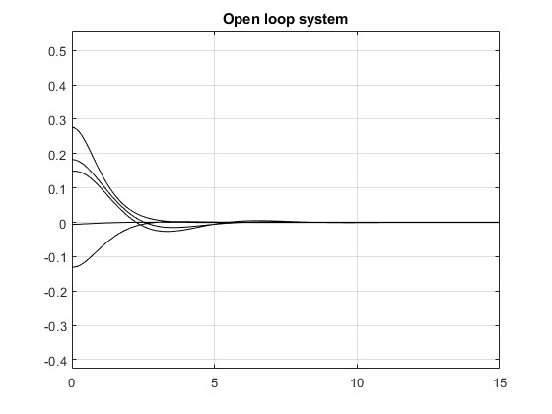
System description and initial analisys
The simple stability of the system is hard to depict, since the simply stable eigenvalues are not the one affecting the state we are monitoring (i.e Δ𝜔𝑖).
The open loop system trajectories of the 5 speed deviations are:
All the calculations have been carried out on a random initial state
x0 =0.1*[0.5377; 1.8339;-2.2588;0.8622;0.3188;-1.3077;-0.4336;0.3426;3.5784;2.7694;-1.3499;3.0349;0.7254;-0.0631;0.7147;-0.2050;-0.1241;1.4897;1.4090;1.4172];
It is important to note that while these states display an asymptotically stable behaviour, the simply stable nature of the system will inevitably affect one or more of the others.
NOTA:METTERE OL DISCRETO

Slide 6
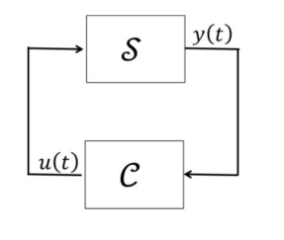
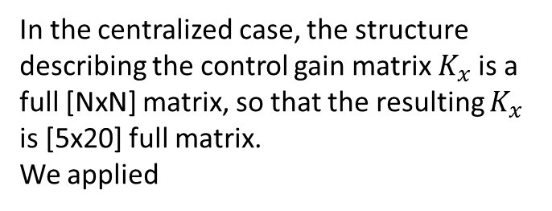
System description and initial analisys
We will consider a state-feedback controller of the following structure:
In the centralized case, the structure describing the control gain matrix $K_{x}$is a full [NxN] matrix, so that the resulting $K_{x}$ is [5x20] full matrix.
We applied

Slide 7
System description and initial analisys

Slide 8
System description and initial analisys

Slide 9
System description and initial analisys

Slide 10
System description and initial analisys
The system is composed by 5 power generation areas, each one displaying 4 states 𝑥𝑖=[Δ𝜃𝑖, Δ𝜔𝑖, Δ𝑃𝑚,𝑖, Δ𝑃𝑣,𝑖]^𝑇, being:
Δ𝜃𝑖: Deviation of the angular displacement of the rotor with respect to the stationary reference axis on the stator.
Δ𝜔𝑖: Speed deviation of rotating mass from nominal value.
Δ𝑃𝑚,𝑖: Deviation of the mechanical power from nominal value (p.u.).
Δ𝑃𝑣,𝑖: Deviation of the steam valve position from nominal value (p.u.).

Slide 11
Each area displays an input Ui, the deviation of the requested load from the nominal value; the system
can therefore be decomposed into 5 subsystem corresponding to the connected areas.
For simplicity, we

